Slide 1
Information Technology
SHASWATI BALA

Slide 2
What is Information Technology?
Information Technology (IT) refers to the use of computers, software, networks, and other digital systems to create, store, process, transmit, and manage information. It includes both hardware (physical devices) and software (programs and applications) used to handle data efficiently.
IT helps individuals and organizations perform tasks faster, communicate easily, store large amounts of data securely, and make better decisions based on information.

Slide 3
Importance of IT
Helps store and manage information safely.
Makes communication faster (emails, video calls, messaging).
Saves time and reduces manual work.
Improves accuracy and reduces mistakes.
Helps businesses manage data and customers.
Supports online education and digital learning.
Improves healthcare through digital records.
Increases productivity and efficiency.

Slide 4
Core Components of IT
The core components of IT are:
Hardware – Physical devices like computers, servers, and printers.
Software – Programs that run on hardware, such as Microsoft Windows.
Data – Information stored and processed by computers.
Networking – Connections that allow devices to share information (like the Internet).
People & Processes – Users and rules that manage and operate IT systems.

Slide 5
Database Management Systems(DBMS)
DBMS (Database Management System) is software that stores and manages data in an organized way.
Examples:
MySQL
Oracle Database
Microsoft SQL Server
MongoDB
Importance:
Keeps data safe
Reduces duplication
Easy and fast access
Supports multiple users

Slide 6
Enterprise Resource Planning
What is ERP?
ERP (Enterprise Resource Planning) is software that helps businesses manage daily activities like finance, HR, sales, inventory, and production in one system.
Features of ERP:
Integrated system (all departments connected)
Real-time data updates
Centralized database
Reporting and analytics

Slide 7
ERP vs CRM
ERP
CRM
ERP is a business management system that helps organizations manage and integrate their core internal processes in one central system. It connects departments such as finance, human resources, production, inventory, and supply chain so that data flows smoothly across the organization. ERP improves efficiency, reduces duplication of work, and helps in better decision-making by providing real-time business information.
Examples: SAP ERP, Oracle ERP, Microsoft Dynamics 365
CRM is a system used to manage a company’s interactions with current and potential customers. It helps businesses track customer information, manage sales activities, monitor marketing campaigns, and provide better customer service. CRM focuses on improving customer satisfaction, increasing sales, and building long-term customer relationships.
Examples: Salesforce, Zoho CRM,

Slide 8
Structured Data
Structured data is highly organized data stored in a fixed format, usually in rows and columns. It is easy to search and analyze using databases.
Example: Data stored in tables using MySQL or Oracle Database (e.g., student records, bank details).
Semi-Structured Data
Semi-structured data does not follow a strict table format but contains tags or markers to organize information. It is partly organized.
Example: XML and JSON files used in web applications like MongoDB.
Unstructured Data
Unstructured data has no predefined format or organization. It is difficult to store in traditional databases.
Example: Images, videos, emails, social media posts (e.g., content shared on Facebook).

Slide 9
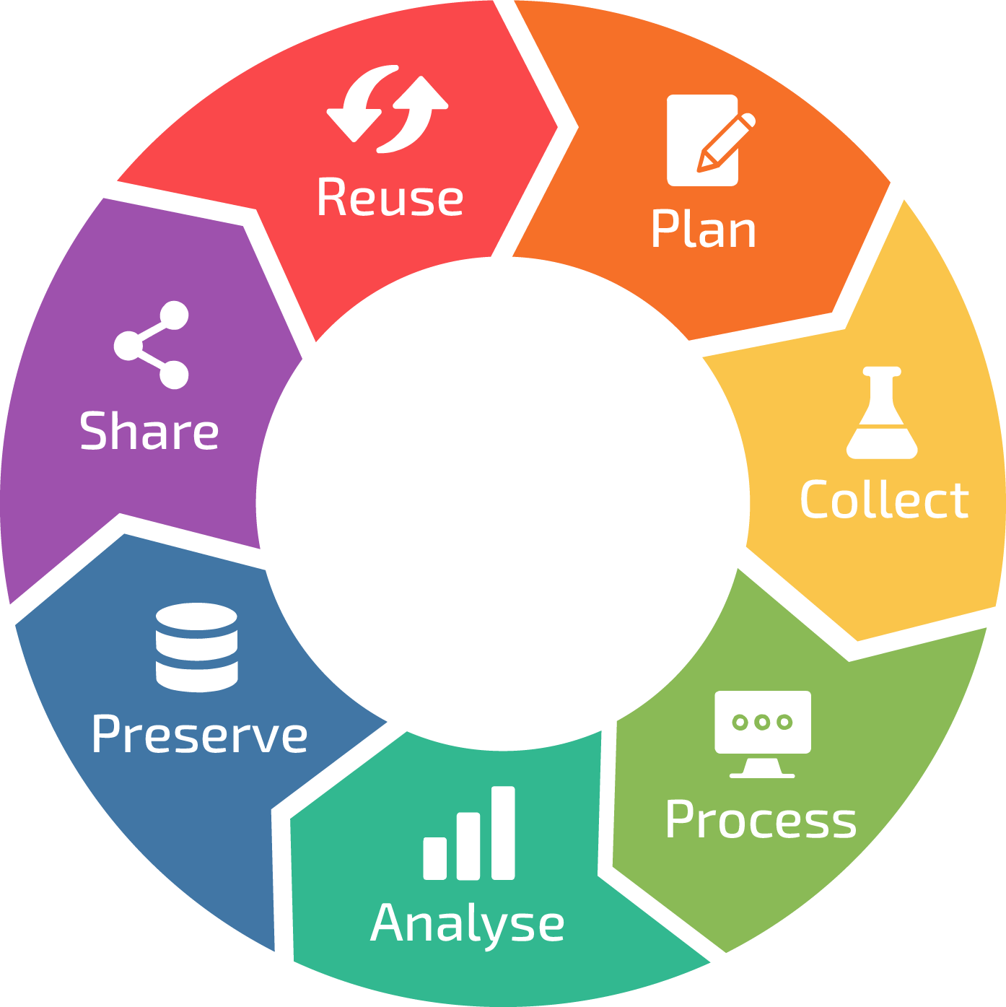
Data Lifetime Management(DLM)
Data Lifecycle Management is a process that manages data from the time it is created until it is deleted or archived. It ensures that data is properly stored, used, protected, and disposed of according to business needs and legal requirements.
Main Stages of Data Lifecycle:
Data Creation – Data is generated or collected (e.g., customer records, transactions).
Data Storage – Data is stored securely in databases or storage systems like Oracle Database.
Data Usage – Data is accessed and used for business operations, analysis, and decision-making.
Data Sharing – Data may be shared between departments or systems.
Data Archiving – Old or inactive data is stored for long-term retention.
Data Deletion – Data is permanently removed when no longer needed.

Slide 10
Responsibilities of a Business Analysts:
A Business Analyst (BA) acts as a bridge between business needs and technical solutions. Their main responsibilities include:
Understanding Business Needs
Identifies business problems and gathers requirements from stakeholders through meetings and discussions.
Requirement Analysis & Documentation
Analyzes and documents functional and non-functional requirements using tools like Microsoft Visio or Jira.
Stakeholder Communication
Communicates between clients, management, and the development team to ensure everyone understands project goals.
Process Modeling
Creates business process models, flowcharts, and diagrams to improve workflows.
Solution Evaluation
Evaluates proposed solutions to ensure they meet business objectives and deliver value.
Testing & Validation Support
Assists in user acceptance testing (UAT) to verify that the system meets requirements.
Continuous Improvement
Suggests improvements to enhance efficiency and productivity.

Slide 11
Business Analysis Methodologies:
Agile Methodology
Agile is a flexible and iterative approach where work is completed in small parts with continuous feedback. It allows changes at any stage and involves regular collaboration with stakeholders.
Example frameworks: Scrum, Kanban.
Waterfall Methodology
Waterfall is a linear and step-by-step approach where each phase (requirements, design, development, testing) is completed before moving to the next. Changes are difficult once the project starts.

Slide 12
Role of BA in Waterfall
Main Responsibilities:
Gather and analyze detailed business requirements
Prepare clear documentation (SRS – Software Requirement Specification)
Communicate requirements to developers and stakeholders
Ensure requirements are approved before moving to the next phase
Support testing by validating that the final product matches the documented requirements
The BA focuses mainly on planning and documentation since changes later are difficult.
Advantages of Waterfall
Simple and easy to understand
Clear structure with defined stages
Well-documented requirements
Disadvantages of Waterfall
Not flexible to changes
Problems may be found late (during testing phase)
Customer feedback comes very late.

Slide 13
Role of BA in Agile
In Agile methodology, the Business Analyst works continuously throughout the project because requirements can change at any time.
Main Responsibilities:
Gather and refine requirements regularly
Create and manage user stories and product backlog
Work closely with the Product Owner and development team
Clarify requirements during sprint planning meetings
Participate in daily meetings and sprint reviews
Advantages of Agile
Flexible and adaptable to changes
Continuous customer feedback
Faster delivery of small working parts
Higher customer satisfaction
Disadvantages of Agile
Less detailed documentation
Scope may change frequently
Requires active stakeholder involvement
Can be difficult to predict final cost and timeline

Slide 14
Scenario Analysis
Scenario analysis is a technique used to evaluate possible future events by considering different “what-if” situations. It helps organizations understand how changes in factors like market conditions, costs, or risks may affect outcomes.
It is commonly used in business planning, risk management, and financial forecasting.
Purpose of Scenario Analysis
To identify potential risks and opportunities
To support better decision-making
To prepare for uncertain future conditions
To improve strategic planning
To reduce unexpected losses
Example
A company plans to launch a new product. It creates three possible scenarios:
Best Case Scenario – High customer demand leads to high sales and profit.
Moderate Scenario – Average demand results in stable but moderate profit.
Worst Case Scenario – Low demand causes low sales and possible loss.

Slide 15
Data Governance
Data governance is a framework of policies, processes, and standards used to manage data effectively within an organization. It ensures that data is accurate, secure, consistent, and used properly across the company.
Main Goals of Data Governance
Improve Data Quality – Ensure data is accurate, complete, and reliable.
Ensure Data Security – Protect data from unauthorized access or misuse.
Maintain Compliance – Follow legal and regulatory requirements.
Standardize Data Management – Create common rules and definitions for data.
Increase Accountability – Assign clear roles and responsibilities for data management.
Support Better Decision-Making – Provide trusted data for business decisions.

Slide 16
Elements of Data Governance
Data Policies & Standards – Rules that define how data should be created, stored, and used.
Data Quality Management – Ensuring data is accurate, complete, and consistent.
Data Security & Privacy – Protecting data from unauthorized access and ensuring confidentiality.
Data Stewardship – Assigning responsible individuals (data stewards) to manage and monitor data.
Data Architecture – Organizing data systems and structures properly.
Metadata Management – Managing information about data (data about data).
Compliance Management – Ensuring data practices follow legal and regulatory requirements.
Benefits of Data Governance
Improves data accuracy and reliability
Enhances data security and reduces risk
Ensures regulatory compliance
Supports better business decisions
Reduces data duplication and errors
Increases accountability within the organization

Slide 17
Ethical Use of Data
Ethical use of data means collecting, storing, and using data in a responsible, fair, and transparent way that respects individuals’ rights and privacy. Organizations must ensure data is not misused, manipulated, or used to harm people.
Key Principles of Ethical Data Use
Transparency – Clearly inform people about how their data is collected and used.
Consent – Obtain proper permission before collecting or processing personal data.
Privacy Protection – Safeguard personal information from unauthorized access.
Fairness – Avoid bias and discrimination in data analysis and decision-making.
Accountability – Take responsibility for how data is managed and used.
Security – Implement strong measures to protect data from breaches.
Purpose Limitation – Use data only for the specific purpose it was collected.

Slide 18
THANK YOU

